Slide 1
Divisione presentazione
Slide 2-6: Matteo (intro + adv)
Slide 7-10: Dennis (auction)
Slide 11: Federico (publisher)
Slide 12-16: Eugenio (step 1, estimation)
Slide 17-18: Federico (step 2, formalization)
Slide 19-22: Matteo (step 3, greedy, bandits)
Slide 24-26: Eugenio (step 4, learning qualities)
Slide 27-30: Dennis (n° arms + greedy)
Slide 31-37: Federico (step 5-6, learning activations)
Numero di slide a testa:
Matteo: 4+4=8
Eugenio: 4/5+3=7/8
Dennis: 4+3=7
Federico: 1+2+4=7

Slide 2
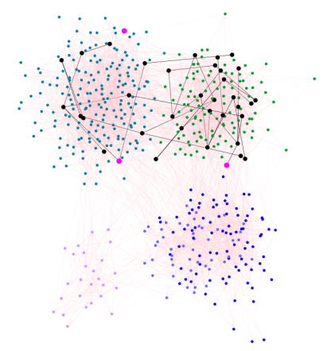
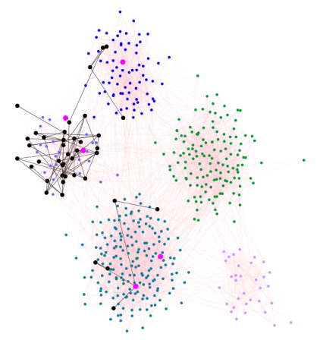

Data Intelligence Applications
Advertising & Social Influence
Federico Innocente, Matteo Marchisciana, Dennis Motta, Eugenio Ostrovan
Notes:
Saluti e presentazione

Slide 3



Problem context
To raise awareness about waste sorting through advertising in a social network
Ads are bite-sized instructions such as:
Where put old electronic devices
How to dispose of cooking oils
Population is divided into 5 categories based on age, occupation and interests.
We study the problem of evaluating and optimizing social influence generated from advertising campaigns.
Seeds are users who share a piece of sponsored information.
A user is activated when they engage with some content shared by some of their friends.
Notes:
We have an advertiser that is competing to raise awareness about waste sorting and recycling through advertising in a social network.
Ads are instructions such as..
Users can share this information with friends and followers, becoming seeds, and those in their turn can engage by liking, commenting, forwarding or just visualizing, becoming activated. We will study the problem of optimizing social influence generated from advertising campaigns.

Slide 4
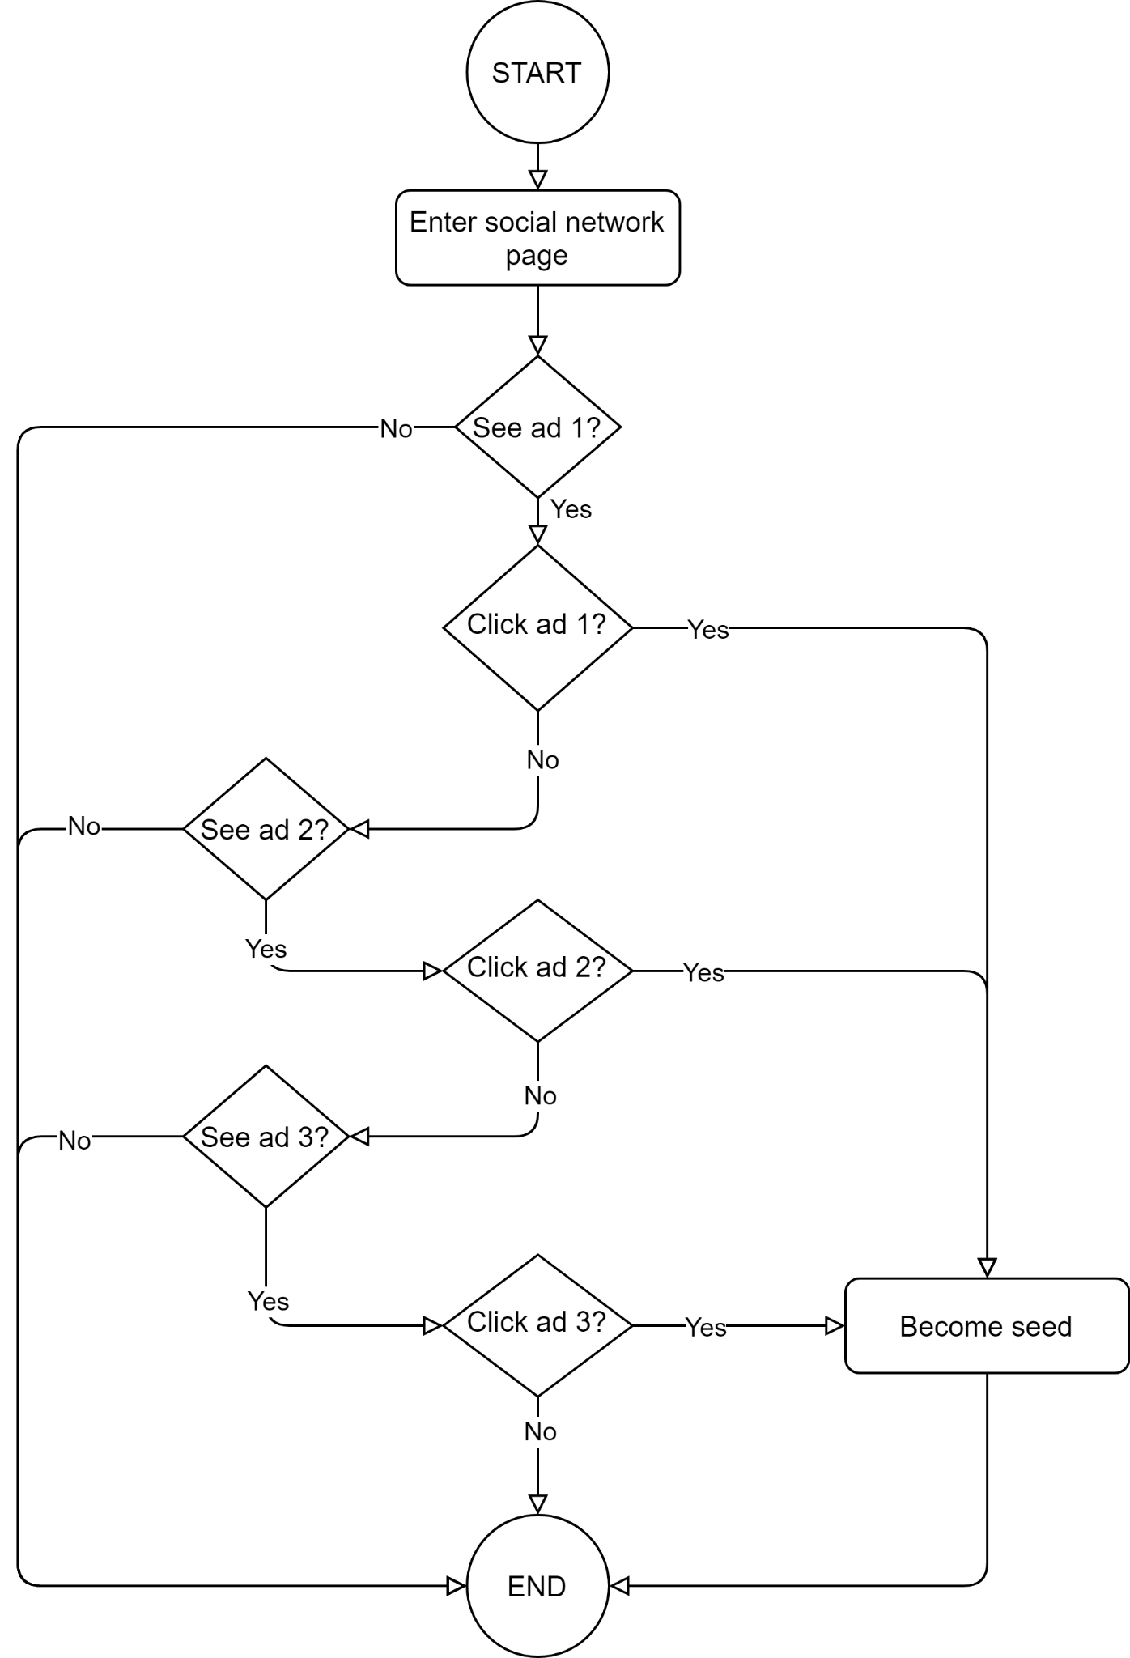
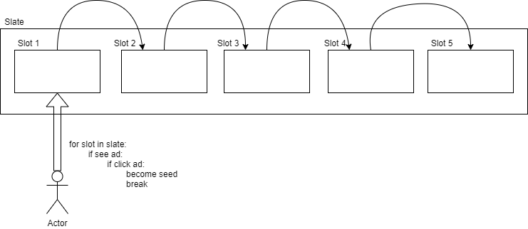
User interaction model
Watch ads in order
Become influence seed for the advertising campaign when clicking ad
Notes:
This is our user interaction model. A user can see a single slate with 6 slot, starting from the first, then the second slot and so on.
From the flowchart to the right we can see that the user has a possibility to both see and click the slots. If it clicks the ad, it will become a seed.
Slots are 6

Slide 5
Components

Slide 6
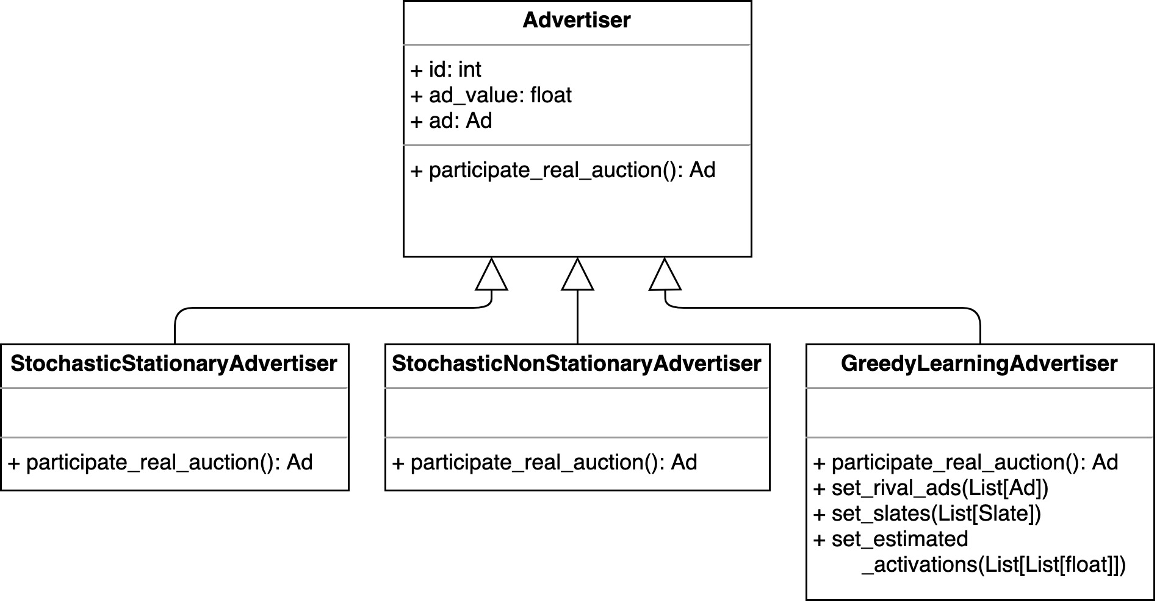
Advertisers
Three classes inherit from the base Advertiser class:
StochasticStationaryAdvertiser
StochasticNonStationaryAdvertiser
GreedyLearningAdvertiser
Notes:
We implemented a base advertiser class that has the ability to participate to an auction, returning an ad. The ad contains all the sufficient information to be used in the auction, such as the quality, the value and the bid for each category.
From the base class, three classes are derived. The stochastic stationary advertiser is an advertiser that, upon creation, randomly generates an ad with random bids, quality and value. The stochastic non stationary advertiser is similar, but it has the ability to regenerate the ad every n steps.
Finally, we created the greedy learning advertiser that is able to simulate the auction and the social influence generated, to find a set of locally optimum bids.

Slide 7


Auction
The auction has the job of managing the competition between advertisers, but user attention is a finite resource for which all advertisers must compete.
The two jobs of the Auction:
Compute the price the advertiser must pay when the user clicks the ad
Assign ads to the slots
Notes:
The next component is the Auction, that has to manage the competition between advertisers because they must compete to gain the user attention.
The two jobs of the auction are:
assigning ad to the slots and computing the price that the advertiser must pay when the user clicks on the ad.

Slide 8
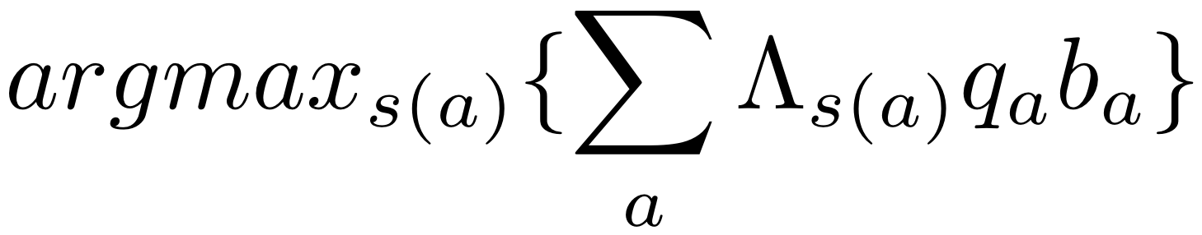
Assigning ads to the slots
The social network will find the allocation that maximizes the expected revenue
Steps:
Sort the ads by decreasing order of quality * bid
Sort slots by decreasing order of observation probability
Assign first-to-first, second-to-second and so on...
Notes:
To assign ads to the slot the auction has to find the allocation that maximizes the expected revenue for the social network.
Expected revenue intended as the multiplication of the slot’s observation probability, the quality of the ad (that represents the click probability) and the bid.
To find this allocation the steps are:
First we sort ads by decreasing order of quality times bid
Then we sort the slots by decreasing order of observation probability
And finally we can assign to the most prominent slot the best ad, to the second most prominent slot the second ad and so on...

Slide 9
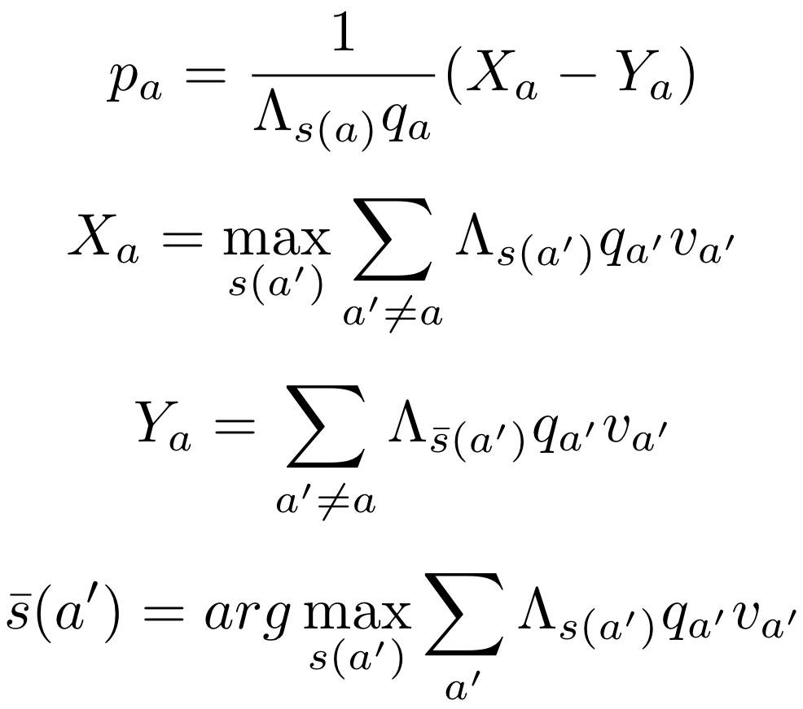
Computing the price
The social network uses a cost-per-click model, the price is calculated using VCG.
p_{a} is the price per click,
X_{a} is the total reward that other ads produce to the social network if ad “a” does not exist
Y_{a} is the total reward that other ads (different than ad “a”) produce to the social network if ad “a” exists
Notes:
The social network uses a cost-per-click model so the auction has to compute the price-per-click of an ad. This price is computed using VCG.
The main variables computed by VCG are:
Xa that is the total reward that other ads create to the social network if ad “a” does not exist.
And also Ya that is the total reward that other ads produce to the social network if ad “a” exists.
So by making the difference of Xa and Ya we are basically computing how much ad “a” is contributing to the reward

Slide 10
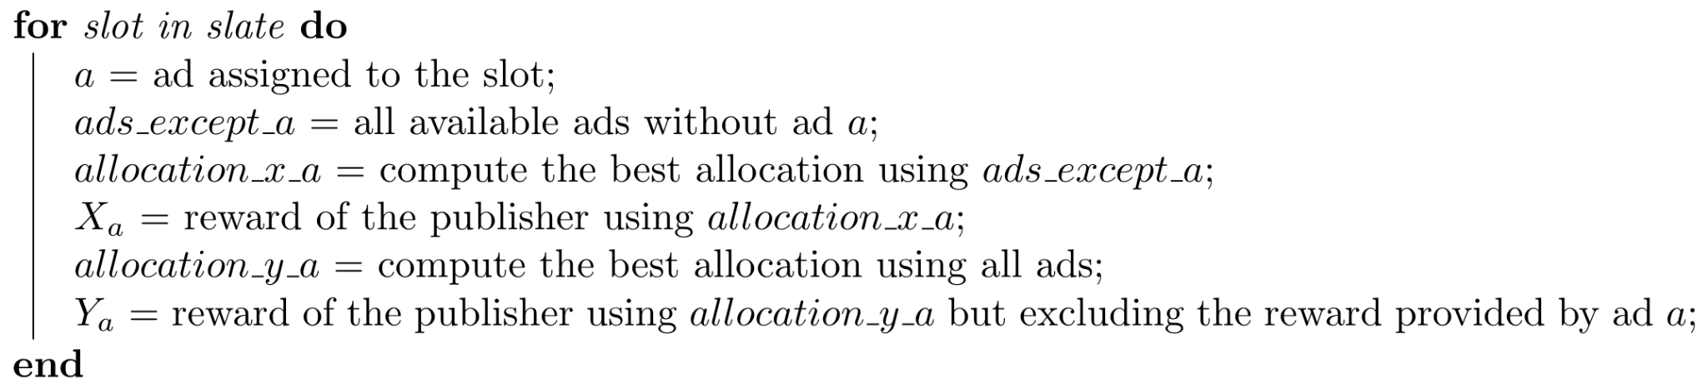
Computing the price: pseudocode
Input: the slate and the available ads
Output: price-per-click for each ad in the slate
Notes:
Here we can see the pseudocode, as input we have the slate with the available ads and for output we need to compute the price-per-click for each ad in the slate.
and as specified previously we are basically computing for Xa the reward without ad “a” and for Ya the reward by considering the existence of ad a but excluding its reward

Slide 11
Publisher
The publisher is an intermediary between the advertisers and the network
Executes the auctions
Publishes the ads
Gets paid by the auctioneers
Provides data to the auctioneers

Slide 12
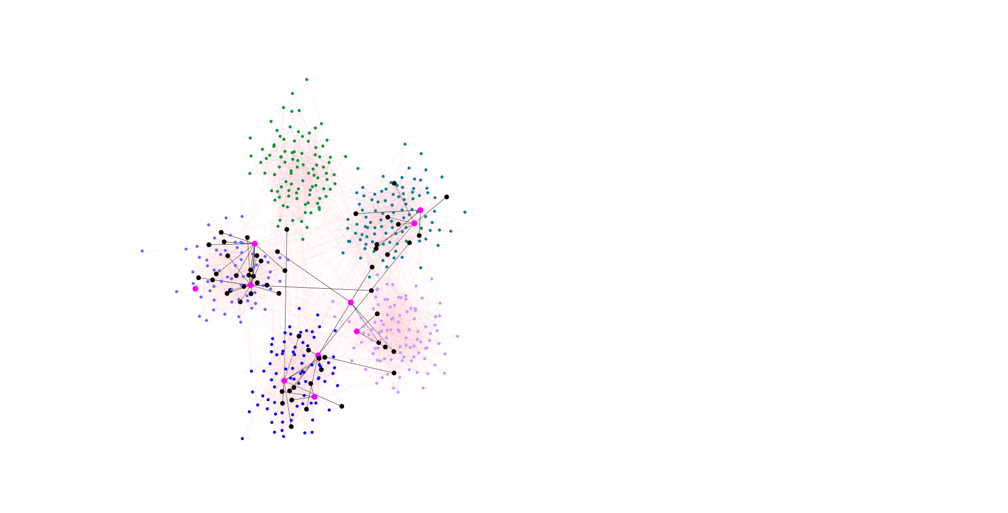
Network
Nodes
Edges
Influence propagation
Seeds
Live edge graph
1
Activated nodes
Notes:
talk about number of neighbours in incìfluence propagation.

Slide 13
Project development

Slide 14
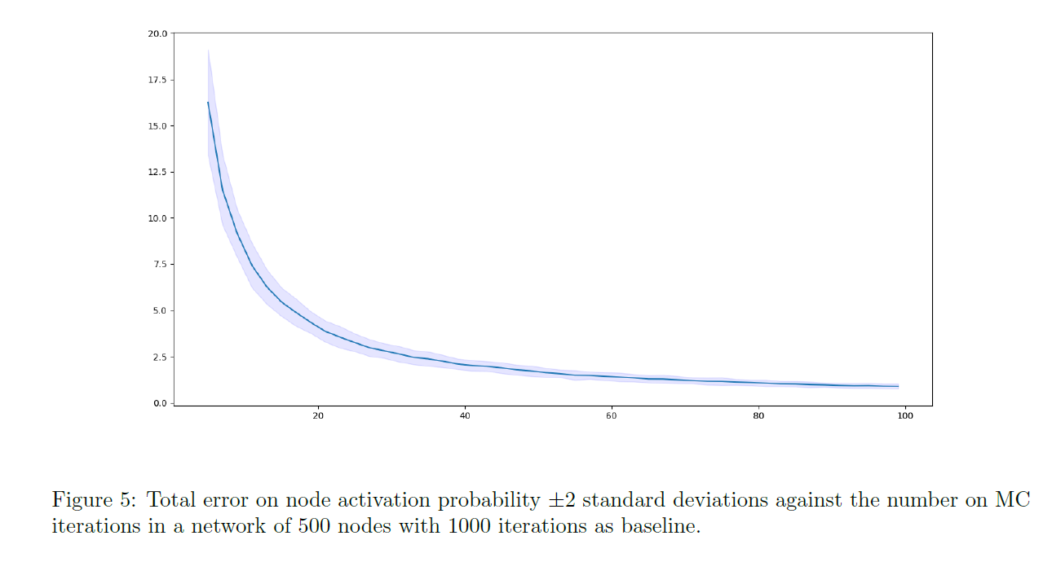
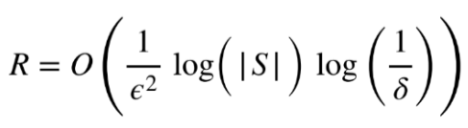
Estimating the effect of a set of bids
Complete enumeration is unfeasible
Monte Carlo estimation
estimation error
Trade-offs
accuracy - speed
size of network - speed
network density - speed

Slide 15
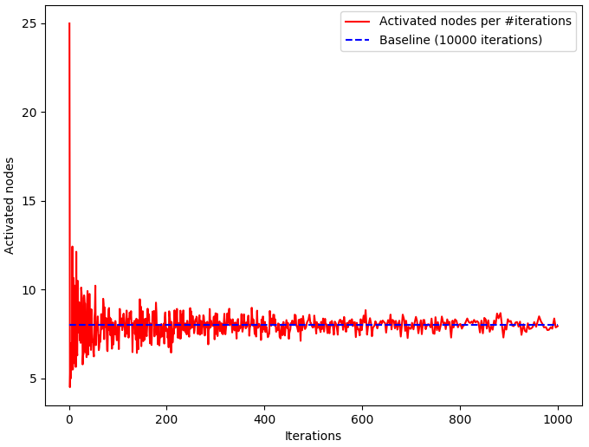
Estimating the effect of a set of bids: #activated-nodes
The only variable changing is the number of iterations for the Monte Carlo estimation
10’000 iterations assumed as baseline

Slide 16
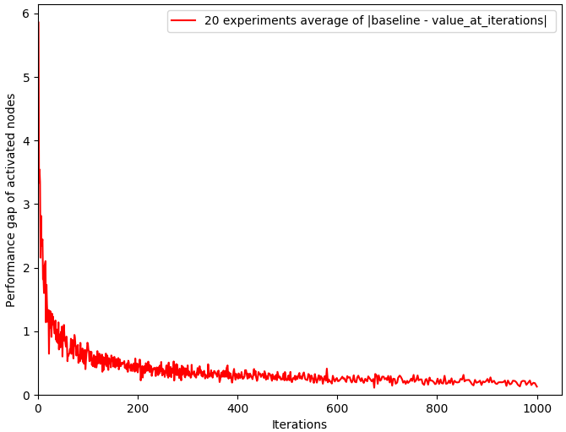
Estimating the effect of a set of bids: average error on #activated-nodes
Error as: |baseline - value|
The more iterations are performed, the more precise it is

Slide 17

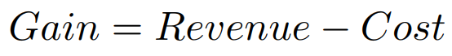
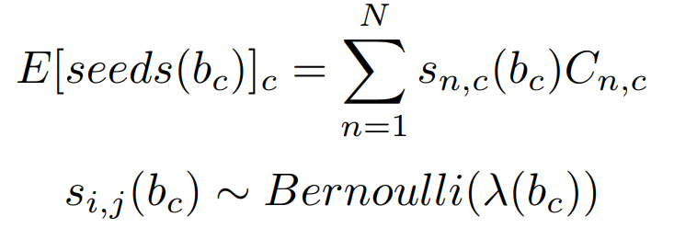
Formalization of the problem (1)
We consider the cost maximization problem for the advertiser:

Slide 18
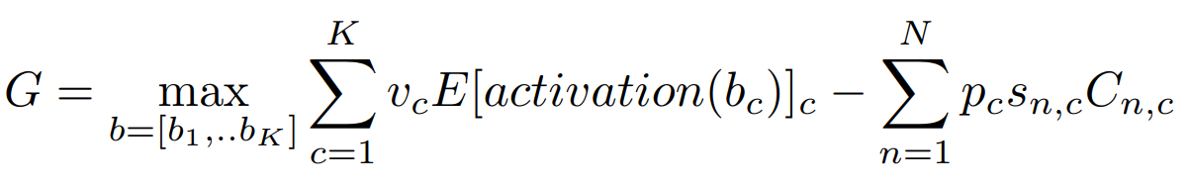
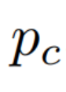
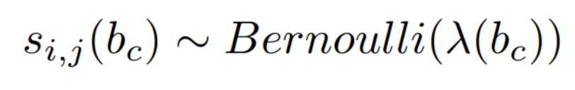
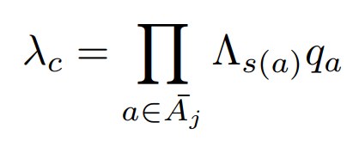
Formalization of the problem (2)
subject to:
is determined by the VCG mechanism

Slide 19
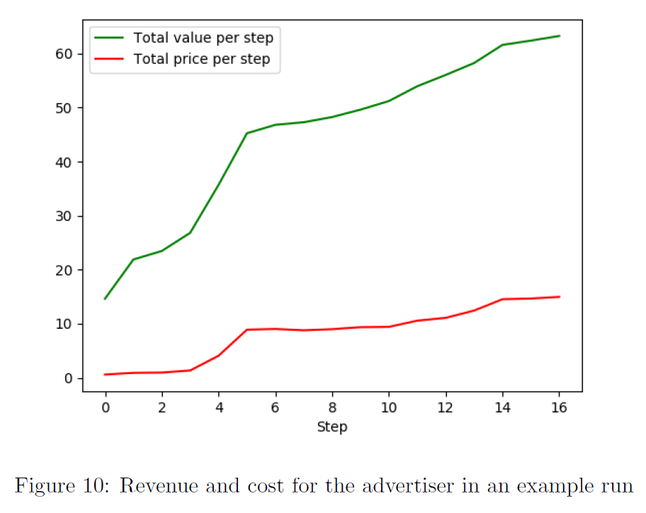
Bidding with a greedy algorithm
Greedy advertiser simulates many auctions to find the set of optimal bids.
Each time, it increases a single bid and runs a simulation.
Computes marginal gain as revenue - cost.
Permanently sets the bid associated with the highest marginal gain to the next level.
PSEUDOCODE
while(marginal_gain > 0):
for each category:
temp_improve_bid[category]
simulate_auction
Compute_marginal_gain
improve_bid[max(marginal_gain)]
Notes:
Here we explain how the greedy advertiser works. As already said before, it has the ability to simulate auctions; to do so, it has the knowledge of the competing ads.
The main loop is like this: for each category, it temporarily increases the bids to the next level while keeping other categories still. It runs the auction with this new set of bids and computes the marginal gain as current gain - gain of the preceding step. It does so for each category and then it finds the category with the best marginal gain, and permanently improves the bid in that category.
From this graph we can see that by increasing the price paid, the advertiser can secure a better slot and gain more value.
It does this improvement loop until there is a least one positive marginal gain, after which it stops and returns the ad with the set of locally optimal bids.

Slide 20
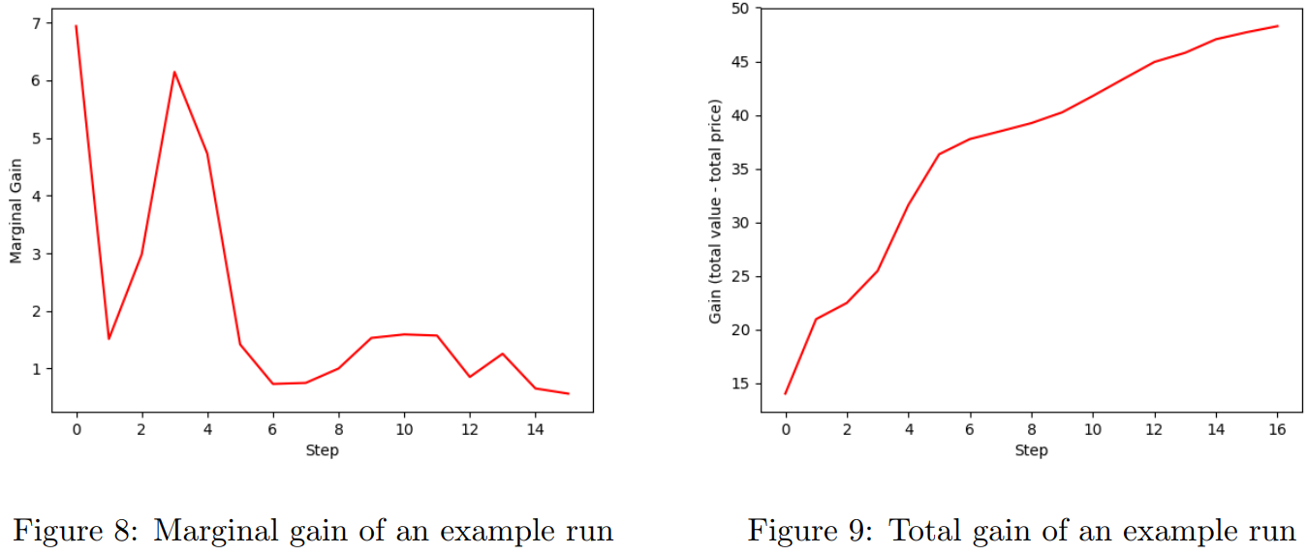
Does it work?
Notes:
Here we show that the algorithm does, in fact, improve the performance of the advertiser as we can see from the graph to the right, where the gain is always increasing.
We also plot to the left the marginal gain of an example run to show that it is always positive until it stops.

Slide 21
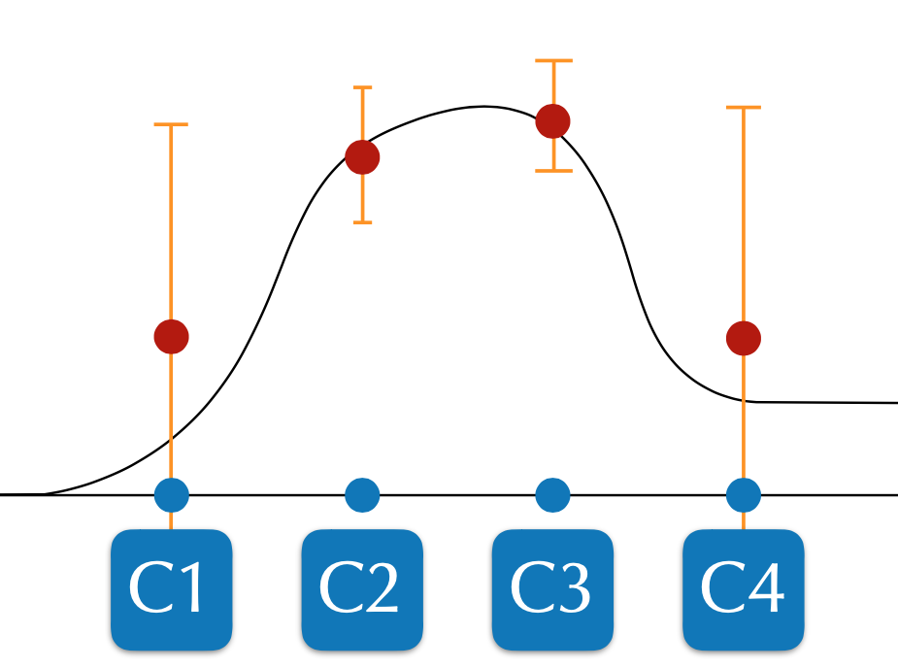
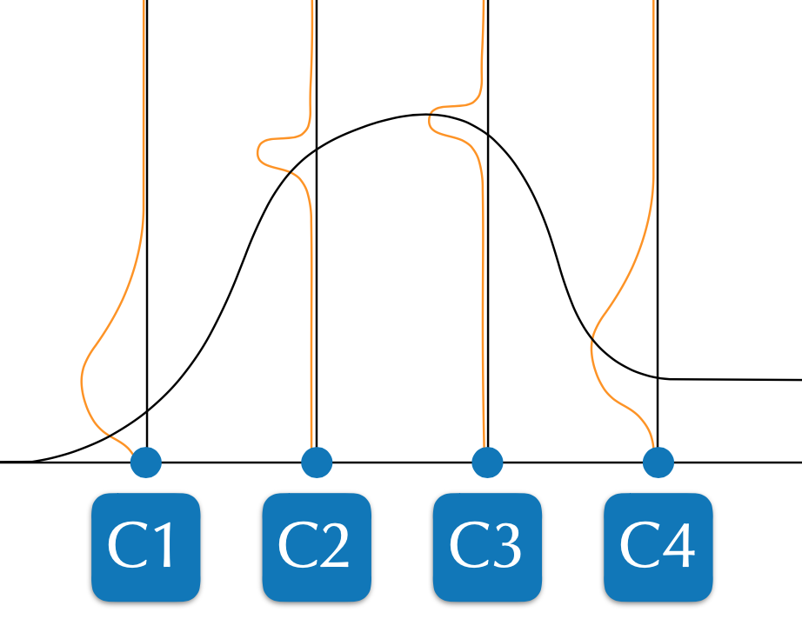
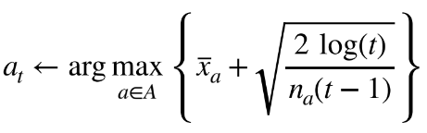
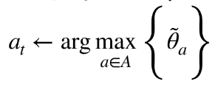
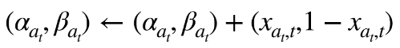
Bandit algorithms
UCB1
Thompson Sampling
Deterministic algorithm
Every arm associated to an upper confidence
Probabilistic algorithm
Every arm associated to a Beta distribution
Notes:
Here we introduce two bandit algorithms that we will use to learn the click probability of an ad and the activation probability of the nodes in the network.

Slide 22

Sliding Window Bandits
The same algorithms and concept but applied only to the latest N samples
It allows to forget the past and adapt to dynamic changes
Bigger regret lower bound due to increased exploration
Notes:
We also make use of the sliding window mechanism to tackle the challenge of a non stationary environment, as the stochastic non stationary advertiser will provide.
It allows to adapt to changes of a dynamic environment, but to do so it must have a bigger exploration factor and so the regret lower bound will be higher.

Slide 23

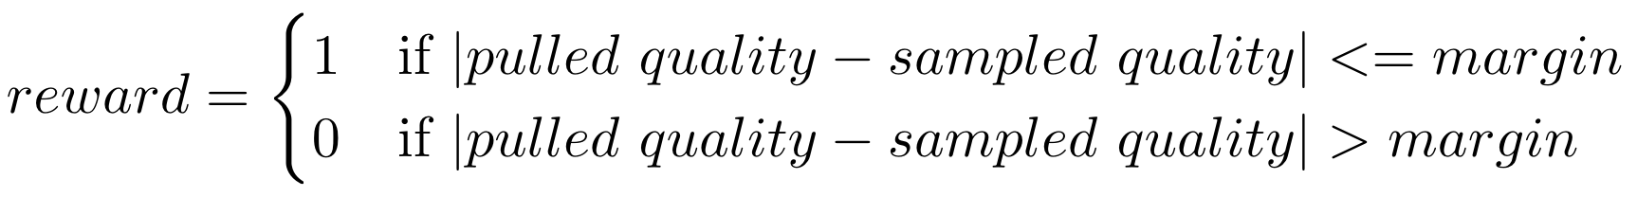
Learning qualities
Publisher and Greedy Advertiser do not know the qualities.
Qualities need to be learned using bandit algorithms
Associate a single [0..1] value of quality for each category for each ad.

Slide 24
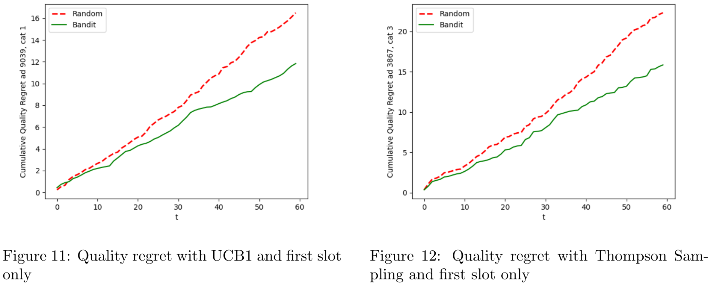
Learning qualities: from first slot only
Less data to learn from
Doesn’t necessarily need to know slots’ observation probability

Slide 25

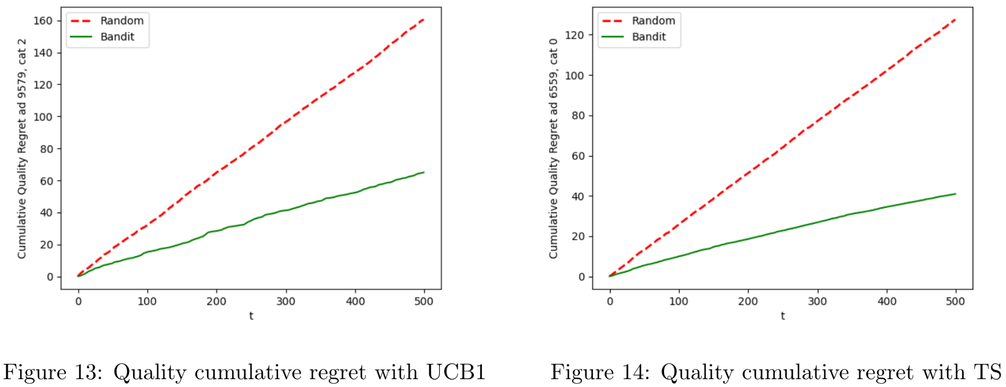
Learning qualities: from all slots
More data
Need to know slots’ observation probability
TS performs better on average...

Slide 26
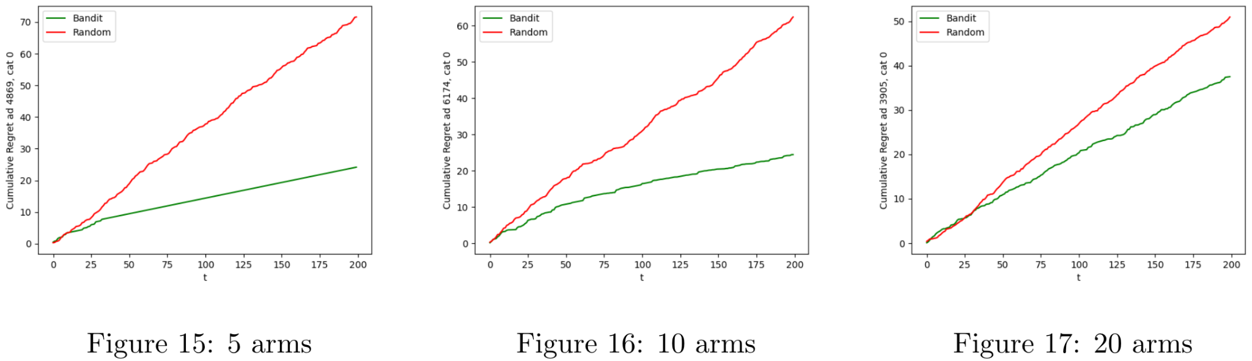
Learning qualities: how many arms?
By increasing the number of arms it becomes harder to learn
Notes:
We also analyzed the performance with different number of arms.
We found that with more arms the learning becomes slower, as we expected from the theory.

Slide 27
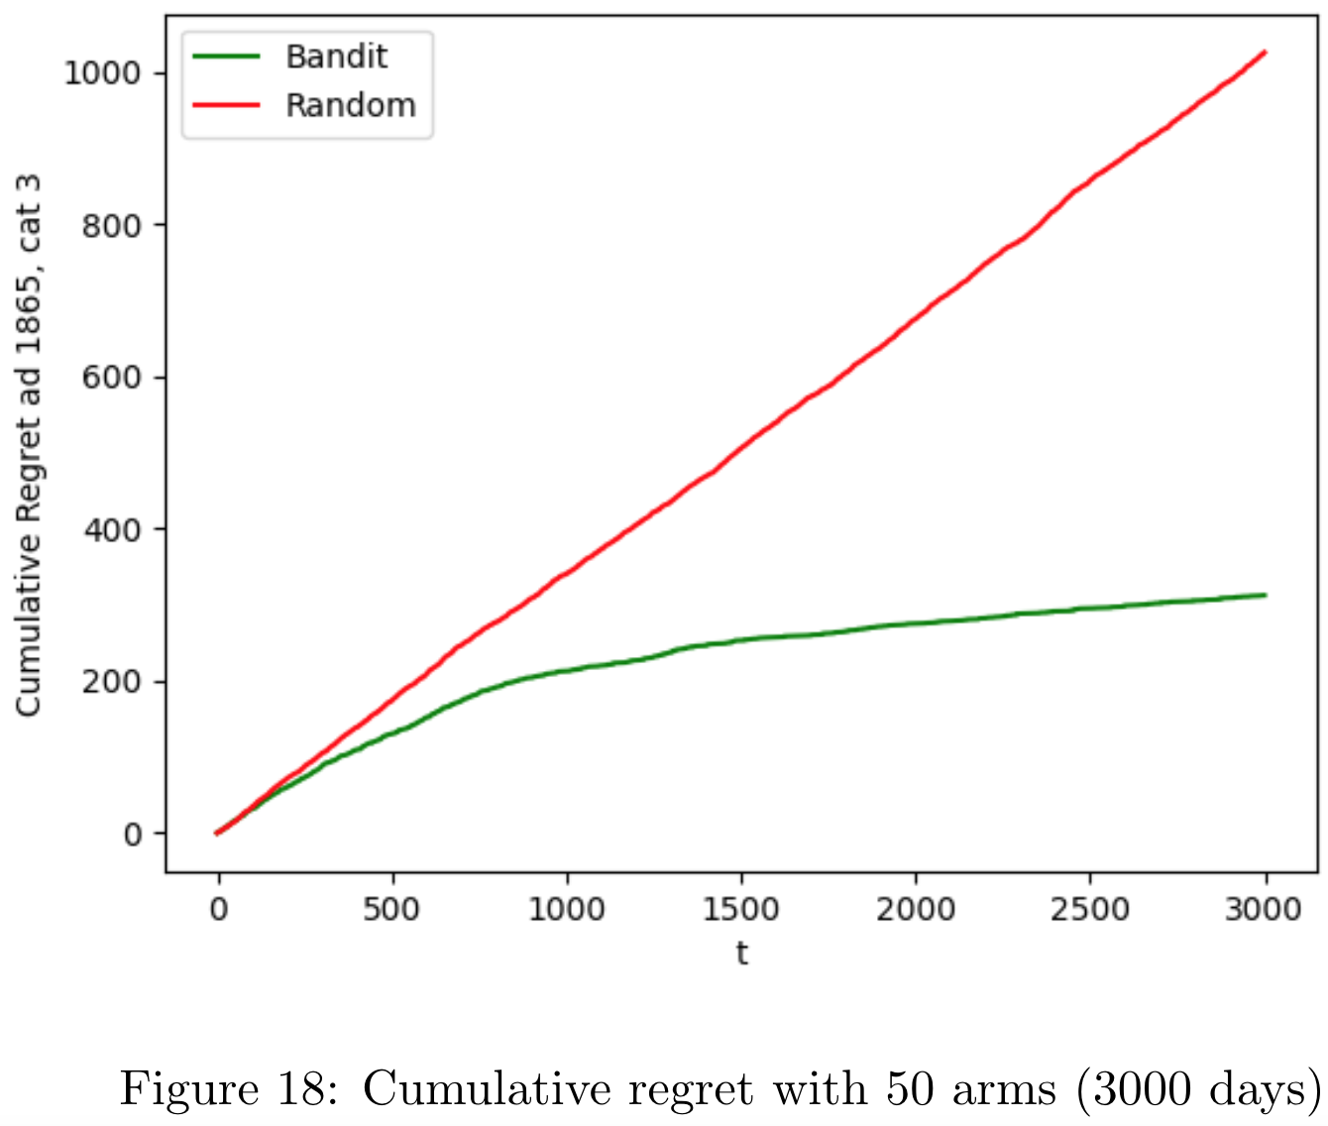
Learning qualities: how many arms?
Better optimums with more arms but slower learning
Notes:
But with more arms we can reach better result.
This is because with more arms it allows to discretize more precisely the interval and the bandit algorithm can reach a result that is closer to the real one.

Slide 28
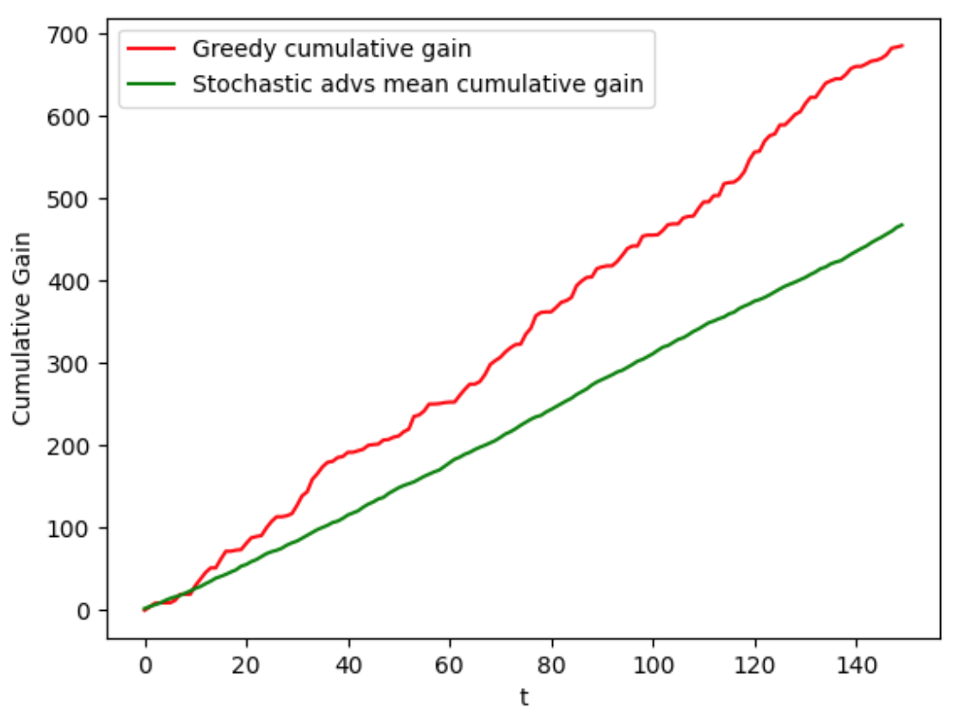
How is the Greedy Advertiser doing?
… it’s doing great!
Notes:
Then we analyzed how the Greedy Advertiser is performing in this scenario, and it is effectively doing great since it can obtain bigger gains than what is being obtained by the stochastic advertisers.

Slide 29

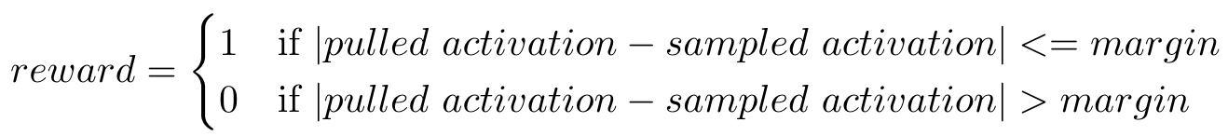
Learning activations
The Greedy Advertiser does not know the activation probabilities.
Activation probabilities need to be learned using bandit algorithms
Associate a single [0..max_probability] value to the connections between categories (categories are the features)
Notes:
sampled activation is the ratio of the edges between the two categories in question which activated in the episode.

Slide 30
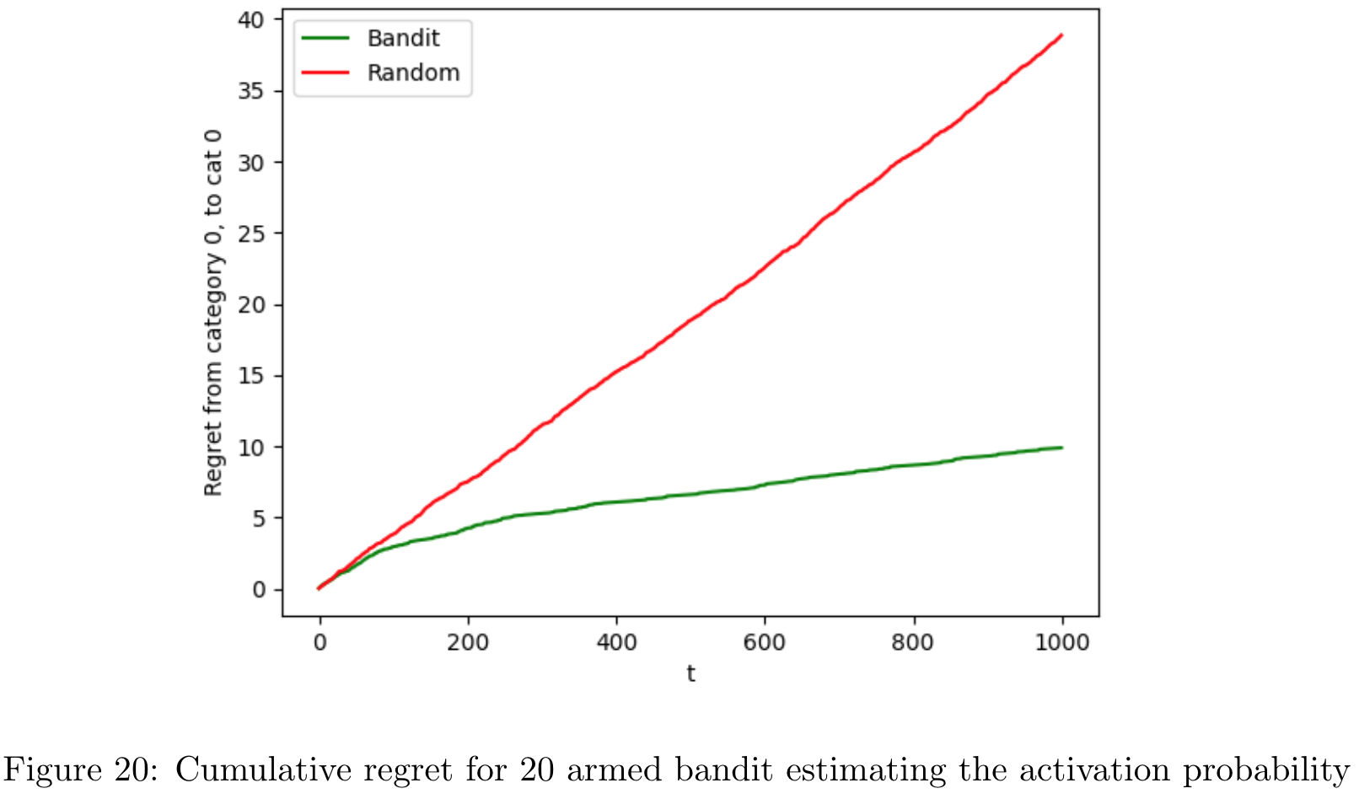
Learning activations: example
Here it is used the Thompson Sampling algorithm applied to the value of the activation probability for edges between nodes of the first category.

Slide 31
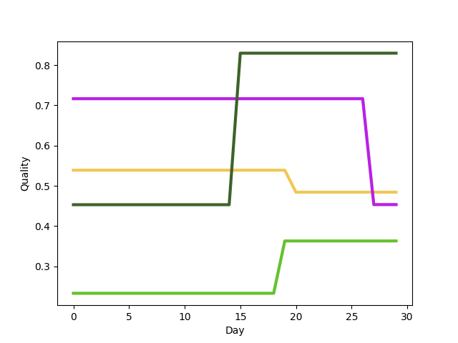
Non stationary context
Stochastic advertiser are non stationary (abrupt change)
Bids and qualities change
Activation probabilities are fixed

Slide 32
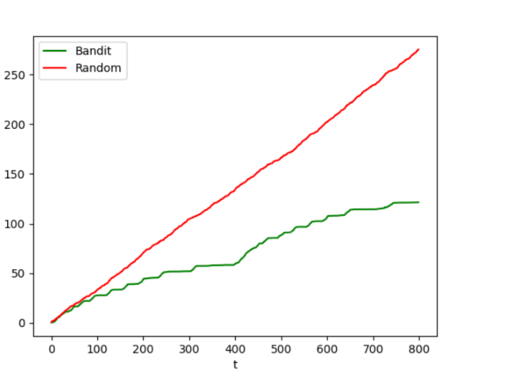
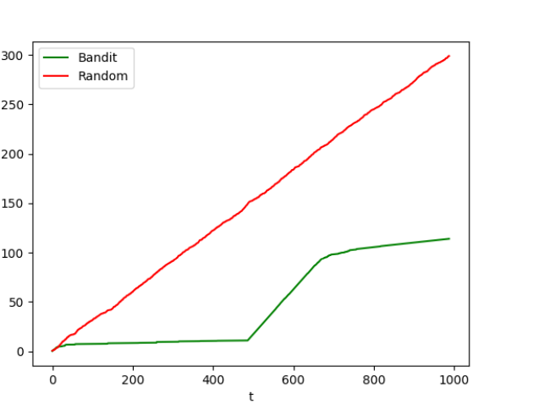
Results
Sliding window dimension sensibility
Reaches a new optimum as soon as many old sample have been discarded

Slide 33

Thank you

